Slide 1
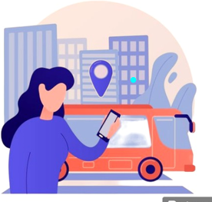
BUS RESERVATION SYSTEM
Team members :
Prinsa Maharjan
Subhawana Kunwar
Sudarshan Khatri

Slide 2
Contents
Introduction
01
Objectives
02
Features
03
Why bus reservation system ?
04

Slide 3
Introduction
When every business adopts intelligent tech resources and gets one step forward to efficiency, why will the
transportation industry be left behind?
The bus reservation system is an automated ticket reservation management software which shifts the
manual system of bus ticket purchasing tradition into an online platform.
Anyone, anytime and from anywhere, people can purchase or book their desired destination bus ticket
online.
It opens up the opportunity to improve the efficiency in transportation maintenance, security, evaluates the drivers and ensure client satisfaction.

Slide 4
User friendly
interface
Schedule
management
OBJECTIVES
Reservation
management
Data security
Real time
updates
Increase
accessibility

Slide 5
Features
Add bus list
Show and update bus list
Show and update passenger list
Show information of passenger
Login and book ticket

Slide 6
Why Adopt Bus Reservation System?
No more standing in long queue
Immediate ticket cancelation option
Proper management of reservation seat
Convenient bus booking ticket system
Maintains precise records of bookings, payments, and customer information.
Offers a modern, tech-savvy service that attracts more customers and stand out
against competitors.
Reduces the need for manual intervention in booking, cancellations, and customer service.

Slide 7

Thankyou
Any quires?

